Slide 1
Unit 3: motion Speed
Mr. Le
Spring 2018

Slide 2
Motion
Motion: a change in position.
We can determine if an object has moved or change position by using a reference point.
Reference Point: An object use to compare if something else has moved or not. Sometimes called as a Frame of Reference.

Slide 3
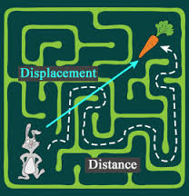
Distance vs Displacement
Distance: the length of your travel. (How much you move)
Displacement: the direction and difference in position between where you started and where you stop. (How far you are from where you started)

Slide 4
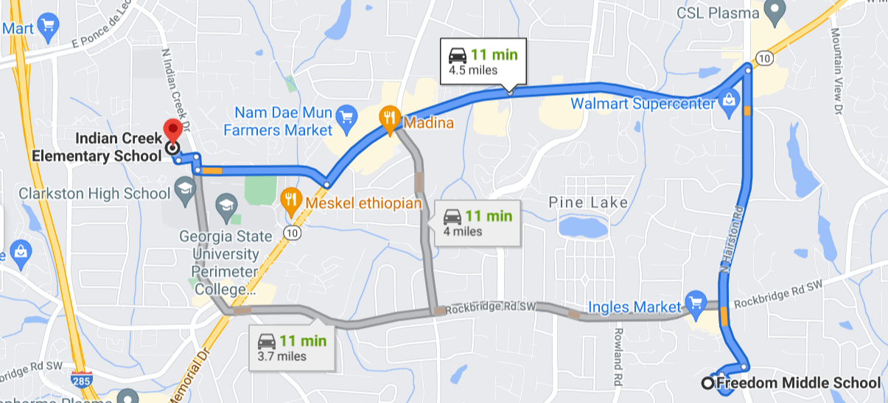
Distance vs Displacement

Slide 5
Find the Distance and displacement
Mr. Le goes north 6 miles.
Mr. Le goes south 4 miles.
Mr. Le goes north 4 miles.
Distance:
Displacement:
Mr. Le goes north 10 miles.
Mr. Le goes south 2 miles.
Mr. Le goes east 6 miles.
Distance:
Displacement:

Slide 6
Scalar and Vector Quantities
In this unit, you will be introduced to several scalar and vector quantities.
Scalar quantities: described with numbers only.
Example:
Distance = 14 feet
Vector quantities: describe with numbers and direction.
Example:
Displacement = 27 miles Northeast

Slide 7
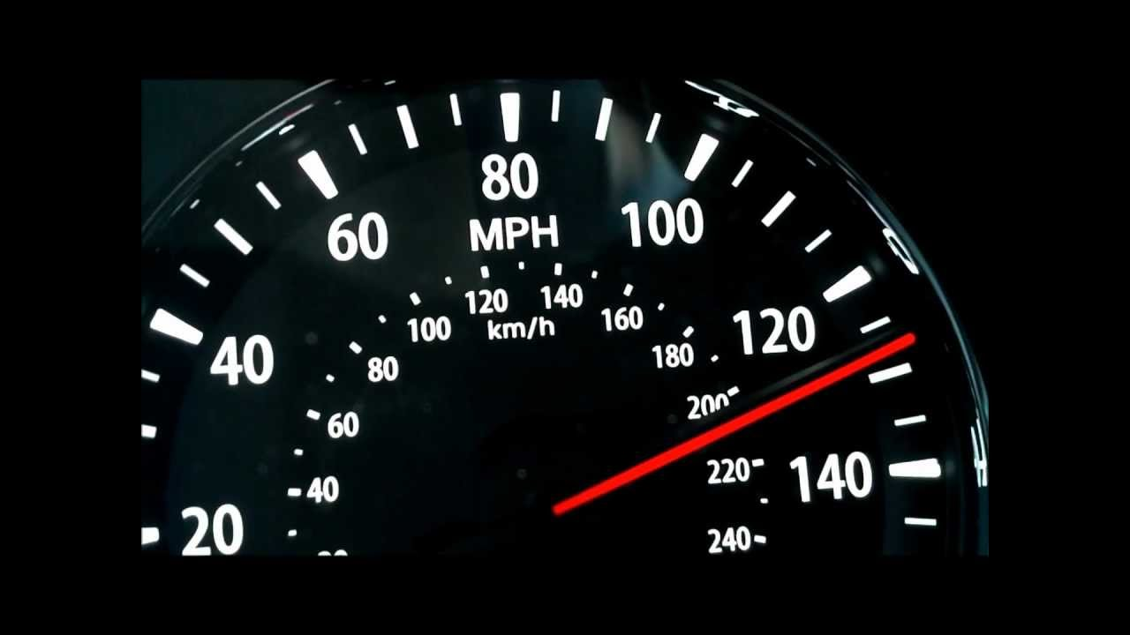
Speed
Speed: the distance an object travels in a period of time.
It is how much you move in a specific amount of time.

Slide 8
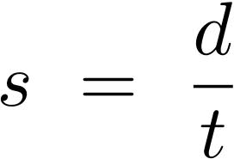
Speed
To find speed, you take the distance an object traveled and divide by the time the object took to travel that distance.

Slide 9
Average vs Instantaneous Speed
Average speed: the total distance traveled divided by the total time taken.
On average, how fast was the object moving
A range, from point (a) to point (b).
Instantaneous speed: the speed of an object at a specific point in time.
At a specific time, what was the object’s speed?
At 1 single point.

Slide 10
Constant Speed
Constant speed: speed that does not change or remains the same over a period of time.
An object traveling at a constant speed will have the same average speed and instantaneous speed.

Slide 11
Unit 3: Motion Graphs
Don’t have to copy this slide.
Mr. Le
Spring 2018

Slide 12
Graphs
Don’t have to copy this slide.
In this next section, you will practice reading two kinds of graphs
Speed (Velocity) vs Time graphs
Distance (Position) vs Time graphs
Pay attention to which kind of graph you are reading because your answers will differ between the two.

Slide 13
Graphs
Don’t have to copy this slide.
Using the graphs, you will be asked to do the following:
Find the distance traveled
Find the object’s displacement
Find the object’s average speed
Find the object’s speed at certain points
Identify what the object is doing at certain intervals
Identify when the object is moving or resting
Identify when the object experiences constant speed
Identify when the object’s speed is increasing
Identify when the object’s speed is decreasing

Slide 14
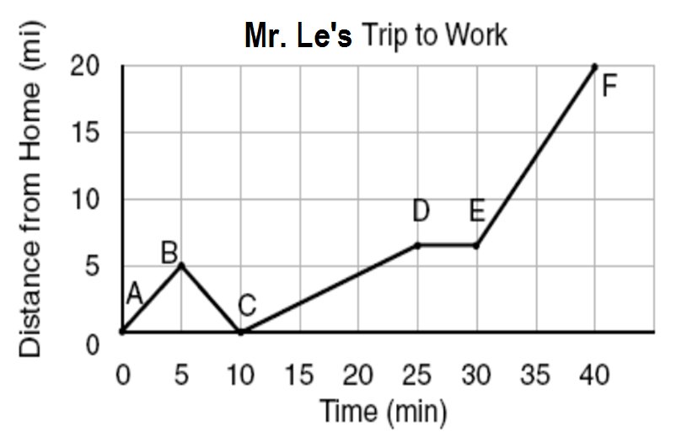
Don’t have to copy this slide.

Slide 15
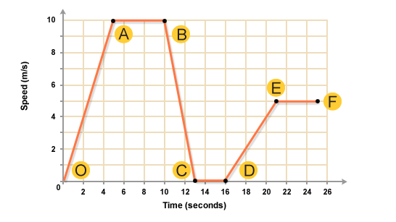
Don’t have to copy this slide.

